Slide 1
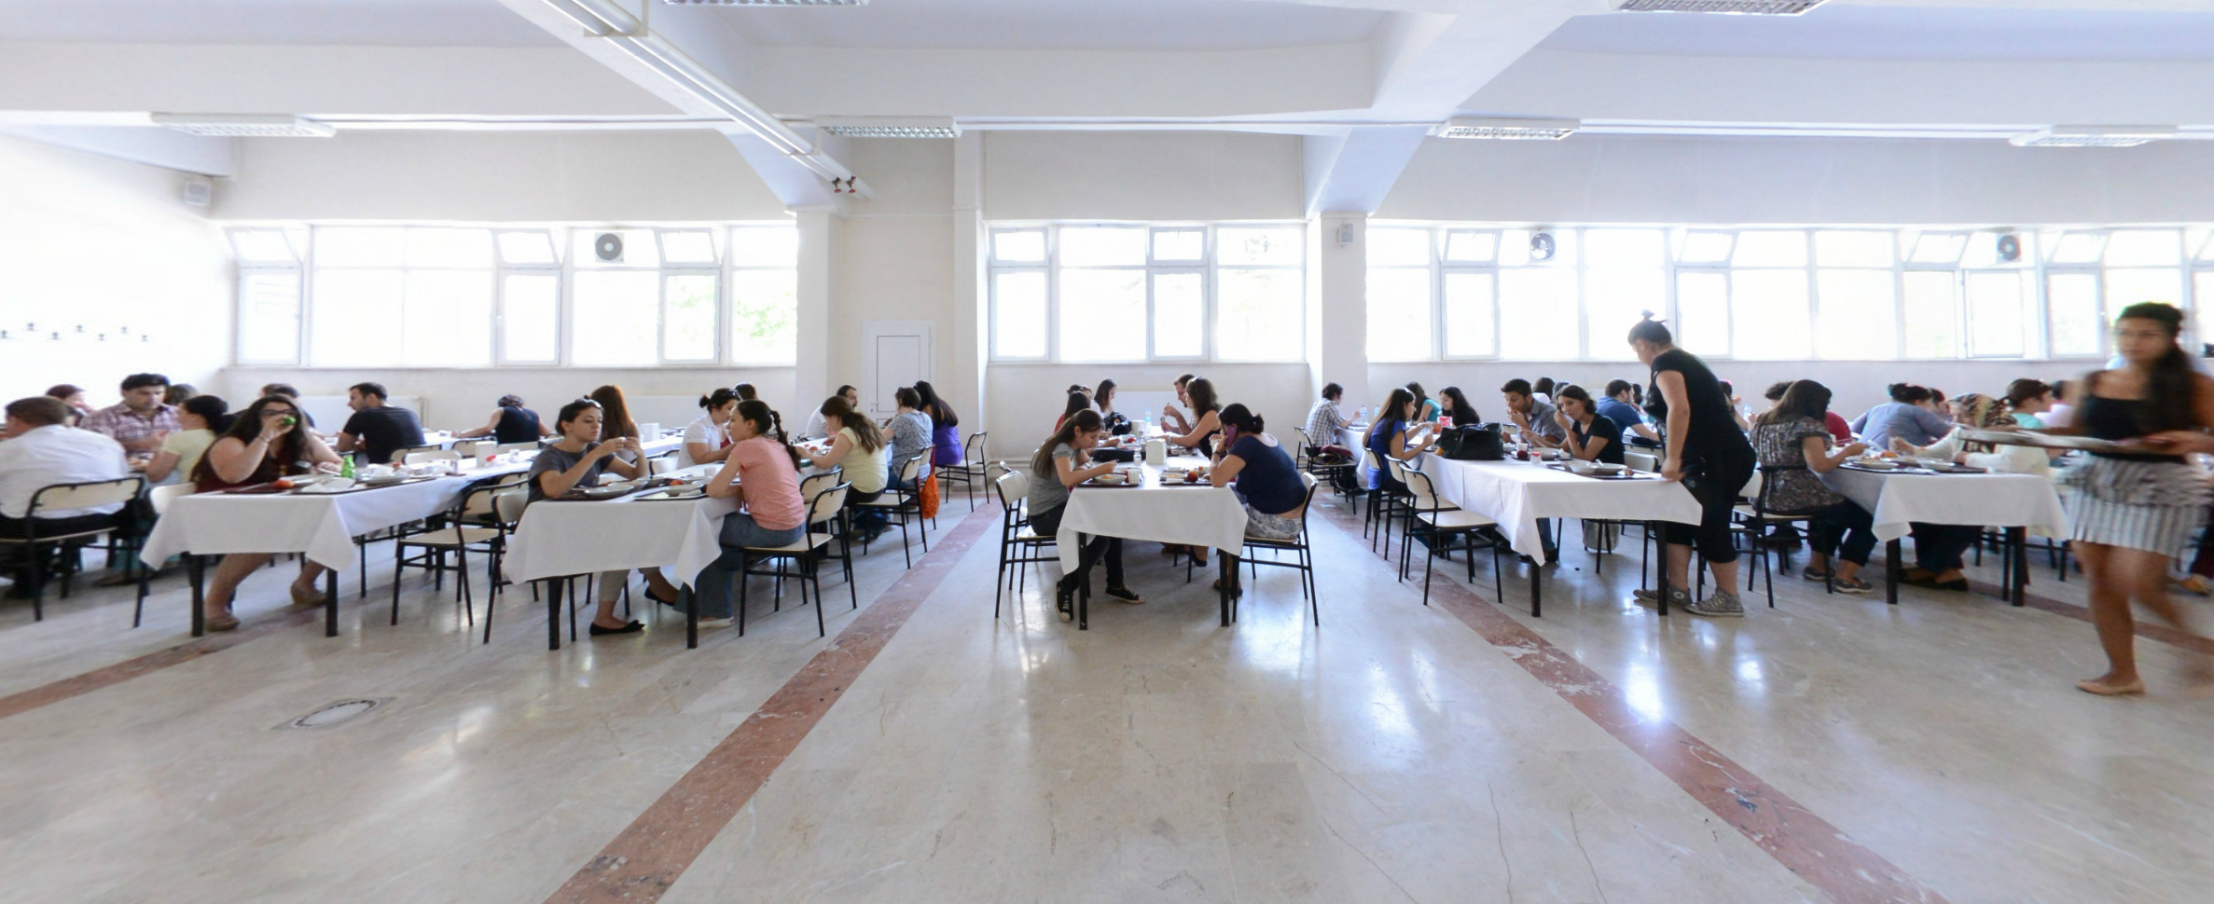
Experiment in Student Cafeteria
By: Islam Musa and Ahmet Sina Kaymak

Slide 2

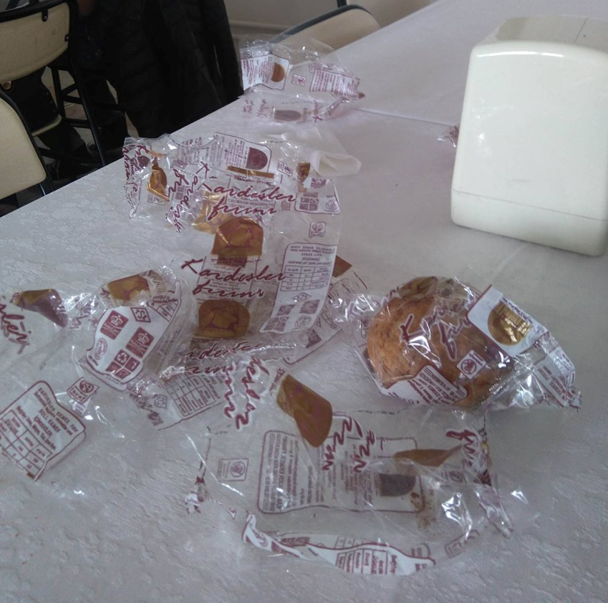
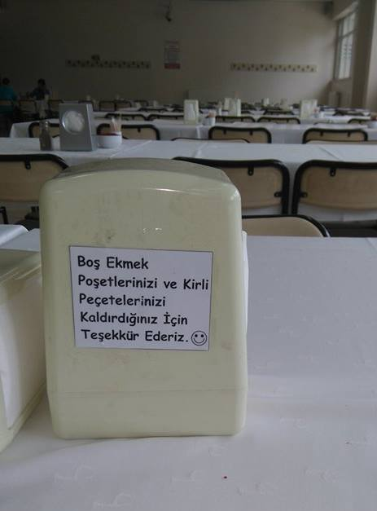
The purpose was to reduce the rubbish in the cafeteria

Slide 3

Case study in Copenhagen
Green Footsteps
Results: Littering in the streets decreased by 46%

Slide 4
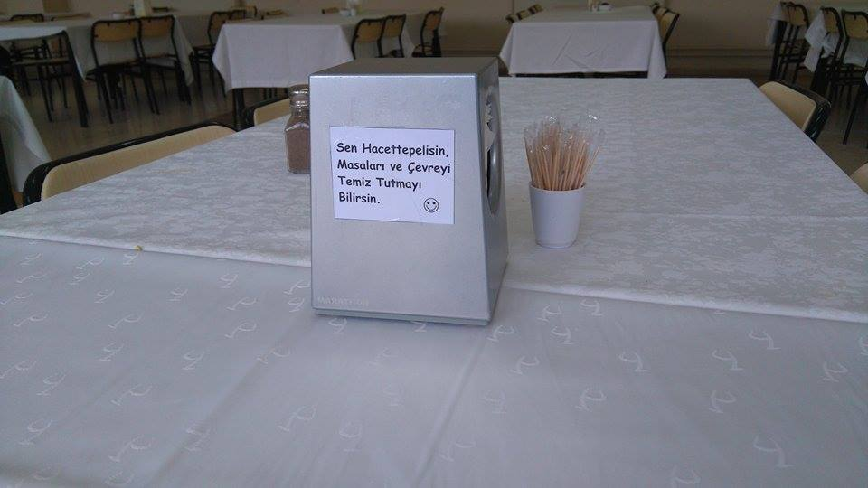
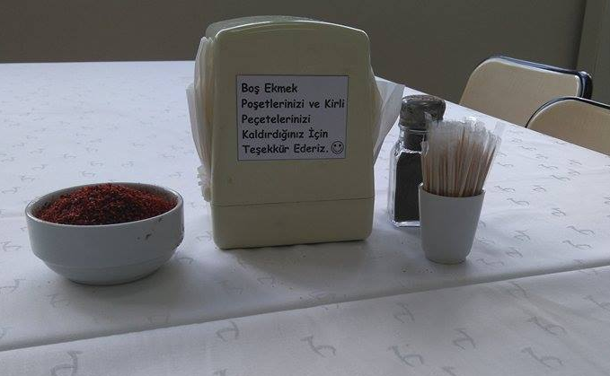
Experiment using Nudge
Sen Hacettepelisin, Masaları ve Çevreni Temiz Tutmayı Bilirsin ☺
Boş Ekmek Poşetlerinizi ve Kirli Peçetelerinizi Kaldırdığınız İçin Teşekkür Ederiz ☺
Lütfen, Masaları Nasıl Bulmak İstiyorsak Öyle Bırakalım ☺
P.S. Budget was 1,75TL ☺

Slide 5
Results
Without Nudge | # of Students | Rubbish Amount Per Person
410 | 1297 | 0,32
400 | 1240 | 0,32
390 | 1158 | 0,34
With Nudge
320 | 1264 | 0,25
290 | 1795 | 0,16
180 | 987 | 0,18

Slide 6
ANOVA results:
Analysis of Variance, response = Y, treatment = X:
Sum of squares df Mean square
Treatment 26666.7 1 26666.7
Residual 11333.3 4 2833.33
Total 38000 5 7600
F(1, 4) = 26666.7 / 2833.33 = 9.41176 [p-value 0.0374]
Level n mean std. dev
0 3 396.667 15.275
1 3 263.333 73.711
Grand mean = 330

Slide 7
Analysis of Variance, response = z, treatment = X:
Sum of squares df Mean square
Treatment 0.02535 1 0.02535
Residual 0.00473333 4 0.00118333
Total 0.0300833 5 0.00601667
F(1, 4) = 0.02535 / 0.00118333 = 21.4225 [p-value 0.0098]
Level n mean std. dev
0 3 0.326667 0.011547
1 3 0.196667 0.047258
Grand mean = 0.261667

Slide 8
Conclusion
The amount of rubbish decreased by 66%
The amount of rubbish per person decreased by 60%

